Slide 1
Routing
Outline
  Algorithms
  Scalability

Slide 2
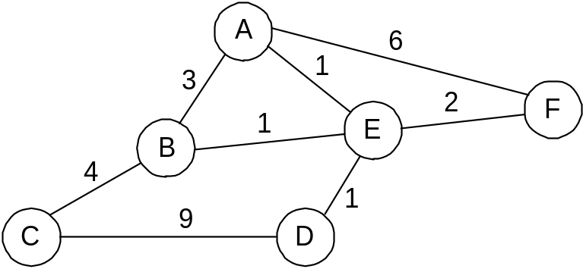
Overview
Forwarding vs Routing
  forwarding: to select an output port based on destination address and routing table
  routing: process by which routing table is built
Network as a Graph
Problem: Find lowest cost path between two nodes
Factors
  static: topology
  dynamic: load

Slide 3
Distance Vector
Each node maintains a set of triples
  (Destination, Cost, NextHop)
Exchange updates directly connected neighbors
  periodically (on the order of several seconds)
  whenever table changes (called triggered update)
Each update is a list of pairs:
  (Destination, Cost)
Update local table if receive a “better” route
  smaller cost
  came from next-hop
Refresh existing routes; delete if they time out

Slide 4
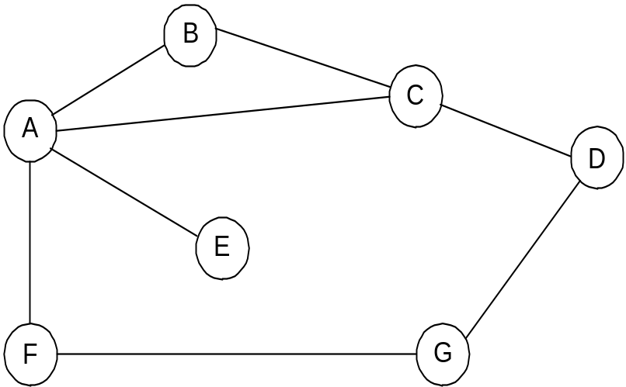
Example
Destination Cost NextHop
A 1 A
C 1 C
D 2 C
E 2 A
F 2 A
G 3 A

Slide 5
Routing Loops
Example 1
  F detects that link to G has failed
  F sets distance to G to infinity and sends update t o A
  A sets distance to G to infinity since it uses F to reach G
  A receives periodic update from C with 2-hop path to G
  A sets distance to G to 3 and sends update to F
  F decides it can reach G in 4 hops via A
Example 2
  link from A to E fails
  A advertises distance of infinity to E
  B and C advertise a distance of 2 to E
  B decides it can reach E in 3 hops; advertises this to A
  A decides it can read E in 4 hops; advertises this to C
  C decides that it can reach E in 5 hops…

Slide 6
Loop-Breaking Heuristics
Set infinity to 16
Split horizon
Split horizon with poison reverse

Slide 7
Link State
Strategy
  send to all nodes (not just neighbors) information about directly connected links (not entire routing table)
Link State Packet (LSP)
  id of the node that created the LSP
  cost of link to each directly connected neighbor
  sequence number (SEQNO)
  time-to-live (TTL) for this packet

Slide 8
Link State (cont)
Reliable flooding
  store most recent LSP from each node
  forward LSP to all nodes but one that sent it
  generate new LSP periodically
    increment SEQNO
  start SEQNO at 0 when reboot
  decrement TTL of each stored LSP
    discard when TTL=0

Slide 9
Route Calculation
Dijkstra’s shortest path algorithm
Let
  N denotes set of nodes in the graph
  l (i, j) denotes non-negative cost (weight) for edge (i, j)
  s denotes this node
  M denotes the set of nodes incorporated so far
  C(n) denotes cost of the path from s to node n
M = {s}
for each n in N - {s}
  C(n) = l(s, n)
while (N != M)
  M = M union {w} such that C(w) is the minimum for
  all w in (N - M)
  for each n in (N - M)
    C(n) = MIN(C(n), C (w) + l(w, n ))

Slide 10
Metrics
Original ARPANET metric
  measures number of packets enqueued on each link
  took neither latency or bandwidth into consideration
New ARPANET metric
  stamp each incoming packet with its arrival time (AT)
  record departure time (DT)
  when link-level ACK arrives, compute
    Delay = (DT - AT) + Transmit + Latency
  if timeout, reset DT to departure time for retransmission
  link cost = average delay over some time period
Fine Tuning
  compressed dynamic range
  replaced Delay with link utilization

Slide 11
How to Make Routing Scale
Flat versus Hierarchical Addresses
Inefficient use of Hierarchical Address Space
  class C with 2 hosts (2/255 = 0.78% efficient)
  class B with 256 hosts (256/65535 = 0.39% efficient)
Still Too Many Networks
  routing tables do not scale
  route propagation protocols do not scale

Slide 12
Internet Structure
Recent Past
Stanford
NSFNET backbone
ISU
BARRNET
…
MidNet
regional
Westnet
regional
Berkeley
regional
P
ARC
NCAR
UNM
UNL
KU
UA

Slide 13
Internet Structure
Today
Large corporation
“
Consumer
”
ISP
Peering
point
Backbone service provider
Peering
point
Consumer
“
”
ISP
“
Consumer
ISP
Large corporation
”
Small
corporation

Slide 14
Subnetting
Add another level to address/routing hierarchy: subnet
Subnet masks define variable partition of host part
Subnets visible only within site
Network number
Host number
Class B address
111111111111111111111111
00000000
Subnet mask (255.255.255.0)
Network number
Subnet ID
Host ID
Subnetted address

Slide 15
Subnet Example
Subnet mask: 255.255.255.128
Subnet number: 128.96.34.0
128.96.34.15
128.96.34.1
H1
R1
128.96.34.130
Subnet mask: 255.255.255.128
Subnet number: 128.96.34.128
128.96.34.139
128.96.34.129
H2
R2
H3
Forwarding table at router R1
Subnet Number Subnet Mask Next Hop
128.96.34.0 255.255.255.128 interface 0
128.96.34.128 255.255.255.128 interface 1
128.96.33.0 255.255.255.0 R2
128.96.33.14
128.96.33.1
Subnet mask: 255.255.255.0
Subnet number: 128.96.33.0

Slide 16
Forwarding Algorithm
D = destination IP address
for each entry (SubnetNum, SubnetMask, NextHop)
D1 = SubnetMask & D
if D1 = SubnetNum
if NextHop is an interface
deliver datagram directly to D
else
deliver datagram to NextHop
Use a default router if nothing matches
Not necessary for all 1s in subnet mask to be contiguous
Can put multiple subnets on one physical network
Subnets not visible from the rest of the Internet

Slide 17
Supernetting
Assign block of contiguous network numbers to nearby networks
Called CIDR: Classless Inter-Domain Routing
Represent blocks with a single pair
(first_network_address, count)
Restrict block sizes to powers of 2
Use a bit mask (CIDR mask) to identify block size
All routers must understand CIDR addressing

Slide 18
Route Propagation
Know a smarter router
  hosts know local router
  local routers know site routers
  site routers know core router
  core routers know everything
Autonomous System (AS)
  corresponds to an administrative domain
  examples: University, company, backbone network
  assign each AS a 16-bit number
Two-level route propagation hierarchy
  interior gateway protocol (each AS selects its own)
  exterior gateway protocol (Internet-wide standard)

Slide 19
Popular Interior Gateway Protocols
RIP: Route Information Protocol
  developed for XNS
  distributed with Unix
  distance-vector algorithm
  based on hop-count
OSPF: Open Shortest Path First
  recent Internet standard
  uses link-state algorithm
  supports load balancing
  supports authentication

Slide 20
EGP: Exterior Gateway Protocol
Overview
  designed for tree-structured Internet
  concerned with reachability, not optimal routes
Protocol messages
  neighbor acquisition: one router requests that another be its peer; peers exchange reachability information
  neighbor reachability: one router periodically tests if the another is still reachable; exchange HELLO/ACK messages; uses a k-out-of-n rule
  routing updates: peers periodically exchange their routing tables (distance-vector)

Slide 21
BGP-4: Border Gateway Protocol
AS Types
  stub AS: has a single connection to one other AS
    carries local traffic only
  multihomed AS: has connections to more than one AS
    refuses to carry transit traffic
  transit AS: has connections to more than one AS
    carries both transit and local traffic
Each AS has:
  one or more border routers
  one BGP speaker that advertises:
    local networks
    other reachable networks (transit AS only)
    gives path information

Slide 22
BGP Example
Speaker for AS2 advertises reachability to P and Q
  network 128.96, 192.4.153, 192.4.32, and 192.4.3, can be reached directly from AS2
Speaker for backbone advertises
  networks 128.96, 192.4.153, 192.4.32, and 192.4.3 can be reached along the path (AS1, AS2).
Speaker can cancel previously advertised paths
Customer P
128.96
(AS 4)
192.4.153
Regional provider A
(AS 2)
Customer Q
192.4.32
Backbone network
(AS 5)
192.4.3
(AS 1)
Customer R
192.12.69
Regional provider B
(AS 6)
(AS 3)
Customer S
192.4.54
(AS 7)
192.4.23

Slide 23
IP Version 6
Features
  128-bit addresses (classless)
  multicast
  real-time service
  authentication and security
  autoconfiguration
  end-to-end fragmentation
  protocol extensions
Header
  40-byte “base” header
  extension headers (fixed order, mostly fixed length)
    fragmentation
    source routing
    authentication and security
    other options

